Slide 1
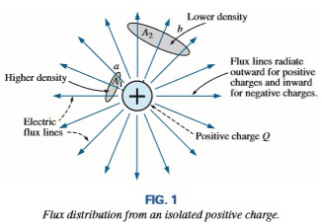
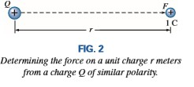
College of Engineering Dept. of the electrical power and Machine engineering
Subject / Electrical Eng. Fundamental II
stage / first Date: 27/2/2018 Lecture:1
Time/ 2 hours
References:
1. Introductory_Circuit_Analysis-12th by Robert L Boylestad 2.
3.
4.
5.
Fundamental electrical circuits By Charles K. Alexander and matthew
Electric circuit By James W. Nilsson
ENGINEERING CIRCUIT ANALYSIS By William H. Hayt, Jr.
Theory and Problems of ELECTRIC CIRCUITS By MAHMOOD NAHVI and JOSEPH
A. EDMINISTER.
Capacitors
THE ELECTRIC FIELD: The symbol for electric flux is the Greek letter c (psi). The flux per unit area (flux density) is represented by the capital letter D and is determined by
By definition, the electric field strength (designated by the capital script letter e) at a point is the force acting on a unit positive charge at that point; that is:

Slide 2
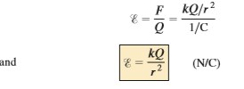
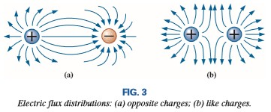
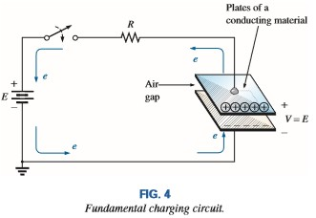
College of Engineering Dept. of the electrical power and Machine engineering
Subject / Electrical Eng. Fundamental II
stage / first Date: 27/2/2018 Lecture:1
Time/ 2 hours
In Fig. 2, the force exerted on a unit (1 coulomb) positive charge by a charge Q, r meters away, can be determined using Coulomb’s law as follows:
electric flux lines always extend from a positively charged body to a negatively charged body, always extend or terminate perpendicular to the charged surfaces, and never intersect
CAPACITANCE
Capacitance is a measure of a capacitor’s ability to store charge on its plates—in other words, its storage capacity. In addition, the higher the capacitance of a capacitor, the greater is the amount of charge stored on the plates for the same applied voltage.
a capacitor has a capacitance of 1 F if 1 C of charge (6.242* 10¹⁸ electrons) is deposited on the plates by a potential difference of 1 V across its plates.

Slide 3
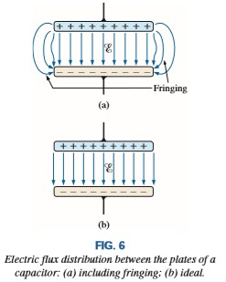
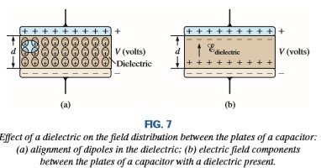
College of Engineering Dept. of the electrical power and Machine engineering
Subject / Electrical Eng. Fundamental II
stage / first Date: 27/2/2018 Lecture:1
Time/ 2 hours
The relationship connecting the applied voltage, the charge on the plates, and the capacitance level is defined by the following equation:
the electric flux distribution appears as shown in Fig. 6(b), where all the flux lines are equally distributed and “fringing” does not occur.
The electric field strength between the plates is determined by the voltage across the plates and the distance between the plates as follows:

Slide 4
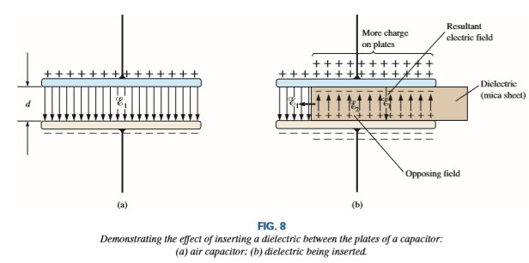
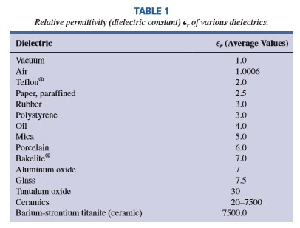
College of Engineering Dept. of the electrical power and Machine engineering
Subject / Electrical Eng. Fundamental II
stage / first Date: 27/2/2018 Lecture:1
Time/ 2 hours
Defining ε_{o} as the permittivity of air, we define the relative permittivity of a material with a permittivity by
Note that ε_{r}, which called the dielectric constant permittivity units (farads/meter (F/m)).
For every dielectric there is a potential that, if applied across the dielectric, will break down the bonds within it and cause current to flow through it. The voltage required per unit length is an indication of its dielectric strength and is called the breakdown voltage.

Slide 5
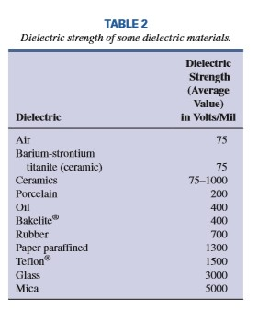
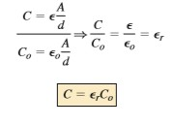
College of Engineering Dept. of the electrical power and Machine engineering
Subject / Electrical Eng. Fundamental II
stage / first Date: 27/2/2018 Lecture:1
Time/ 2 hours
A typical example of dielectric breakdown is lightning, which occurs when the potential between the clouds and the earth is so high that charge can pass from one to the other through the atmosphere (the dielectric).
The average dielectric strengths for various dielectrics are tabulated in volts/mil in Table 2 (1 mil 1>1000 inch). One of the important parameters of a capacitor is the maximum working voltage. It defines the maximum voltage that can be placed across the capacitor on a continuous basis without damaging it or changing its characteristics. For most capacitors, it is the dielectric strength that defines the maximum working voltage.
or if we substitute the known value for the permittivity of air, we obtain the following useful equation:
If we form the ratio of the equation for the capacitance of a capacitor with a specific dielectric to that of the same capacitor with air as the dielectric, the following results:
the capacitance of a capacitor with a dielectric having a relative permittivity of ε_{r} is ε_{r} times the capacitance using air as the dielectric.

Slide 6
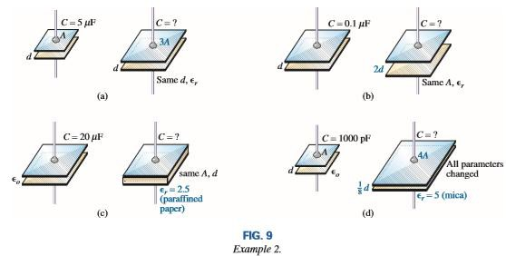
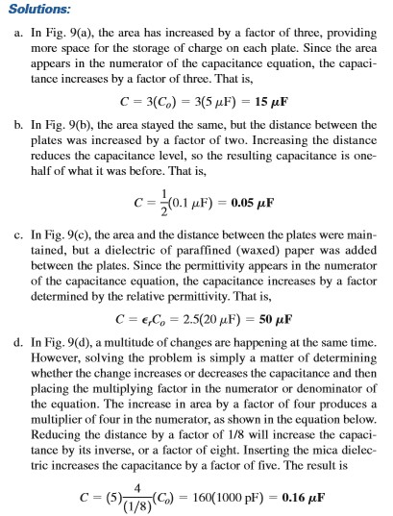
College of Engineering Dept. of the electrical power and Machine engineering
Subject / Electrical Eng. Fundamental II
stage / first Date: 27/2/2018 Lecture:1
Time/ 2 hours
EXAMPLE 2 In Fig. 9 , if each air capacitor in the left column is changed to the type appearing in the right column, find the new capacitance level. For each change, the other factors remain the same.

Slide 7
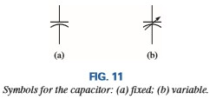
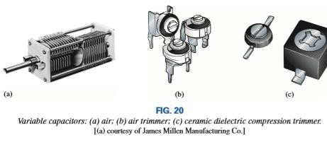
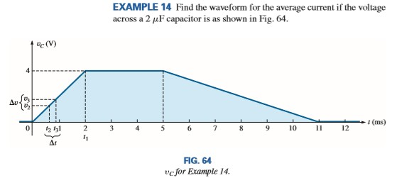
College of Engineering Dept. of the electrical power and Machine engineering
Subject / Electrical Eng. Fundamental II
Types of Capacitors
stage / first Date: 27/2/2018 Lecture:1
Time/ 2 hours
Fixed Capacitors Fixed-type capacitors come in all shapes and sizes. However, in general, for the same type of construction and dielectric, the larger the required capacitance, the larger is the physical size of the capacitor.
Variable Capacitors All the parameters can be changed to some degree to create a variable capacitor. For example, in Fig. 20(a), the capacitance of the variable air capacitor is changed by turning the shaft at the end of the unit
THE CURRENT iC
The capacitive current is directly related to the rate of change of the voltage across the capacitor, not the levels of voltage involved.

Slide 8
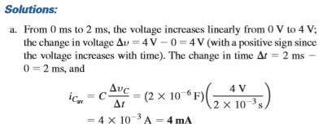
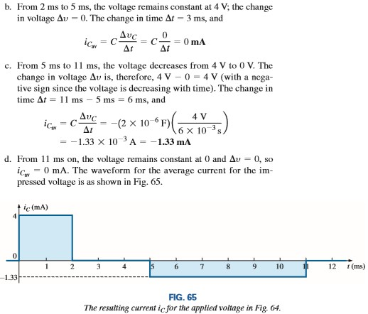
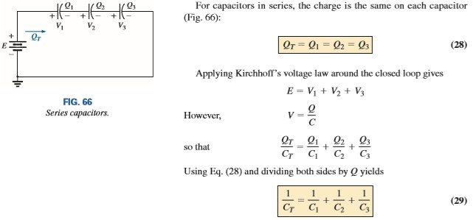
College of Engineering Dept. of the electrical power and Machine engineering
Subject / Electrical Eng. Fundamental II
stage / first Date: 27/2/2018 Lecture:1
Time/ 2 hours
CAPACITORS IN SERIES AND IN PARALLEL

Slide 9
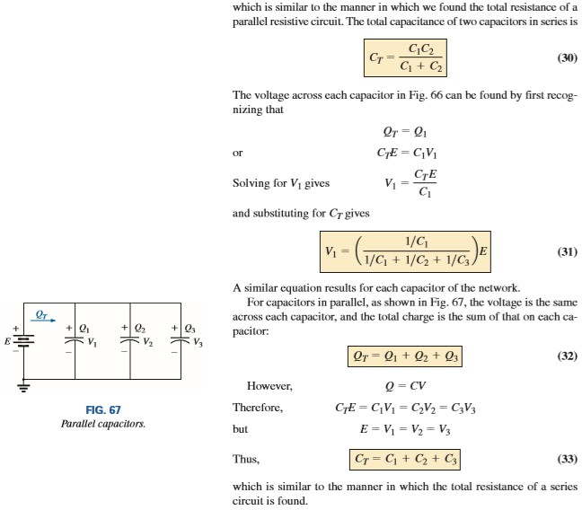
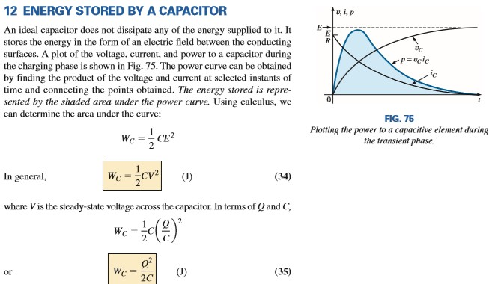
College of Engineering Dept. of the electrical power and Machine engineering
Subject / Electrical Eng. Fundamental II
stage / first Date: 27/2/2018 Lecture:1
Time/ 2 hours

